Slide 1
FAA Building Blocks Leading to UAS Integration
Airworthiness and Operational Integration

Slide 2
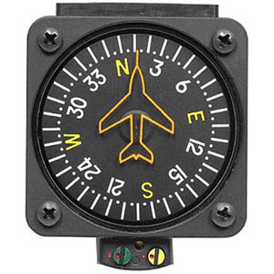
UAS: FAA Guiding Principles
Collaboration
  Shared Responsibility For Safety & Innovation
  Will Be Mutually Beneficial
  Responsive to Innovation
Managed Risk Approach to Certification
  Conservative, but not a “Zero Risk” Approach
  Promote Safe Use of Technology
Unique Design and Operational Risks
  Traditional Certification, Risk Assessment, and Mitigations May Not Apply
Notes:
Thank you for hosting us here in Moscow for this important discussion on Unmanned Aircraft Certification and Integration
My name is Wes Ryan, and I am the National Certification Policy Director for Aircraft Certification for Design and Airworthiness of Unmanned Systems. I have been with the FAA for 15 years, and was previously their Manager of New Technology.
I want to start by sharing a few of the top level guiding principals we will be discussing while we are here.
First, we welcome this collaboration and recognize that we all have a shared responsibility for the safety of unmanned aircraft as they integrate into our existing airspace, and for creating a regulatory environment that is open to respond to innovation.
Second, we believe it will be beneficial to use a managed risk approach to certification of unmanned systems, so you will hear us talking about a risk-based approach to certification and integration in all our materials today.
We have learned that a “Zero risk” mentality, or expecting to be able to completely remove all risk from Unmanned aircraft operations is not possible. Instead, we need to promote the safe use of technology.
There are unique design and operational challenges for Unmanned systems that we must address properly. To be successful, this means we may not be able to apply traditional certification requirements, risk assessment methods, and other mitigations that are used in manned aircraft certification.

Slide 3
Key Concept - Risk-Based Approach
Large UAS / high impact energy
Defining Scalable Safety Assurance Requirements
Full UAS Integration
Passenger Operations
Aeronautical Information Infrastructure for UAS
Small Cargo / Non-Segregated Operations
Automated Low Altitude Authorization
Expanded Operations
Operations Over People
Part 107 Operations
Operations by Exemption
Low-risk, Isolated
Small UAS / low impact energy
Within VLOS or isolated operating area
Beyond VLOS or populated operating area
Notes:
I mentioned a risk based approach to UAS integration. This chart shows how we are starting with low risk, low altitude operations and working our way to full UAS integration.

Slide 4
UAS Operations
Increasing Risk | Aircraft Requirements | UAS Registration | Pilot Requirements | Types of Operation | Airspace Requirements
Part 101 Model Aircraft | UAS < 55 pounds *unless otherwise certified through a CBO | Registration not required* *Voluntary registration encouraged | Community-Based Organization (CBO) standards | Hobby or recreational, VLOS, Part 101 operating rules, CBO standards | Notification requirement within 5 miles of an airport
Part 107 | UAS < 55 pounds | Register through Small UAS Registration Service | Part 107 remote pilot certificate with small UAS rating | VLOS, daytime, Class G, 400 ft, not over people OR waiver provisions | Airspace waiver or authorization for Class B, C, D, E airspace
Section 333 | As specified in exemption | For UAS > 55 pounds, N-number registration required | Part 61 airman certificate | UAS > 55 pounds | Blanket COA or standard COA for specific airspace
Public Aircraft | Self-certification by public agency | For UAS > 55 pounds, N-number registration required | Self-certification by public agency | Public Aircraft Operations (AC 00-1.1A); UAS Test Site Operations | Blanket COA or Standard COA for specific airspace
Experimental Aircraft | Experimental Special Airworthiness Certificate | For UAS > 55 pounds, N-number registration required | Part 61 airman certificate | Research and Development, crew training, and market survey | Standard COA for specific airspace
Type Certificated Aircraft | Restricted type or special class certificate | For UAS > 55 pounds, N-number registration required | Part 61 airman certificate | Specified in operating authorization | Part 91 airspace requirements

Slide 5

Risk-Based Regulatory Structure
Hobbyist/Recreational Operations
Low Altitude Small UAS (Part 107)
  In Line of Sight of Operator
Operations Over People (107 Expansion)
  Working Regulation Now
Beyond Visual Line Of Sight (Permit to Fly)
  Enable Low Risk, Small UAS First
Integrated/Controlled UAS Ops (TC/PC)
  Changes to ATM and Mature Technology
Future Automation – “Pilotless” Ops
  Only as ATM and Automation Allow
Integrated
Operations
Hobbyist
Public UAS
Operations
Part 107 Civil
(Commercial)
Expanded
Operations
Future Rulemaking and Waivers
Notes:
This chart illustrates the status of our current regulatory structure, and the changes we are making to safely expand unmanned operations.

Slide 6


What is “Certification”
Acknowledgement FAA requirements met for:
  Aircraft, Aeronautical Products, Airmen, Mechanics, Controllers, Operators, etc.
Well Proven, Risk-based processes for each
  They are not all the same thing and do not always apply
  Each process serves a purpose to manage risk
Notes:
Before we go much further in describing our regulations, I want to talk about what certification means to the FAA.
It is an acknowledgment, or recognition, that a particular thing meets the applicable regulations.
We have processes for aircraft, the equipment on them, for pilots, mechanics, air traffic controllers, and operators
All these processes are meant to provide a risk-based, multi-level regulatory structure to give us safe aircraft designs and operations.
They are not all the same, and are applied in a risk based manner, depending on the type of operation and aircraft.
For example, we have light sport aircraft requirements for small aircraft in day time operations.
This is not the same as what is applied to larger transport aircraft carrying hundreds of passengers.
This structure that we have created gives us the safe system we have today, yet allows for affordable new products to be brought into the market in a risk-based manner.
Not all products are treated the same, based on the number of passengers, the performance of the aircraft, etc.

Slide 7

Why Certify UAS?
Manage Design & Operational Risk to Public
  Apply FAA Resources/Rigor Based on Risk
Certification manages risk through “Safety Assurance”
  Confidence a proposed product or action will meet FAA safety expectations to protect the public
Safety Does not Rely on Luck
  Requires Active Risk Management and Risk Based Decision Making
Notes:
We certify aircraft because we are legally responsible to manage the design and operations for civil aircraft.
The FAA must apply its limited resources to higher risk projects, and let our mature industry handle the lower risk projects.
We manage risk by gaining safety assurance in our products, using the regulations we have in place.
The idea of safety assurance is just that – we have a reasonable expectation, or confidence, that the new product or operation will be safe.
From our experience, safety cannot just rely on luck, but comes from active risk management and risk based decision making for our level of oversight of a product.

Slide 8
“Safety Assurance” Risk Controls
Comes from Combination of Established Processes/Factors
Airworthiness: Condition for safe flight for its intended use
Design: Verify design, engineering, construction, etc. meet applicable requirements in certification basis
Pilot: Train for aircraft and level of risk
Maintenance: Repair/replace prior to failure
Operation: Limitations sufficient for the expected/acceptable level or risk
Airspace: Level of Integration, Traffic Exposure, Controller Involvement, and Equipage
Notes:
The risk controls we have in place are a combination of processes to look at the following:
Aircraft airworthiness – the condition for safe flight.
The design of the aircraft and whether it meets our engineering requirements.
The training of the pilot and if they can handle the performance and risk of the aircraft.
The maintenance so we repair or replace items before they become a safety issue.
The operations, where the limitations on the design are sufficient to allow safe operations.
And the airspace, where the level of integration drives equipment, and interaction with air traffic.

Slide 9


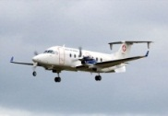




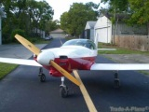
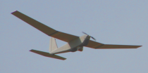

Existing Safety Continuum Expectations
Part 25 Transport Category Passenger Aircraft
Zero Risk
No Operations
No Innovation
Society’s Demand for Safe Outcomes
Large Part 25 Business Jets
Part 23 Commuter Aircraft
Part 23 Business Jets
Part 23 Light Jets, Twins
Part 23 Single Engine
Light Sport Aircraft
Societally Accepted Risk
& Desire for Low Cost
Amateur Built
Models
Toys
Level Of Certification Rigor & Oversight
Notes:
So everything we do should be in the context of risk based decision making, applying the right level of rigor for the type of aircraft and operation.
The green and yellow bars represent the level of FAA work that is done to make sure a product is safe.
We apply a high level of oversight and certification to large manned aircraft.
Society does not expect the same safety level to be applied to all aircraft, since certification can be expensive and cause products to be expensive if we apply a high level of certification to a low risk product.
The chart shows how we add FAA oversight as we go from small aircraft to larger manned aircraft with passengers.

Slide 10



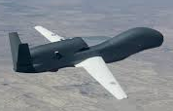
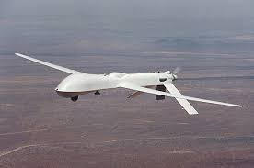
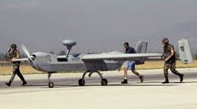
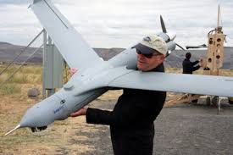
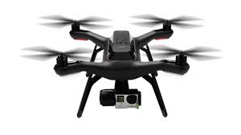
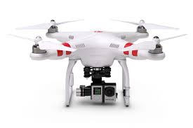
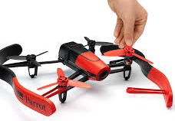
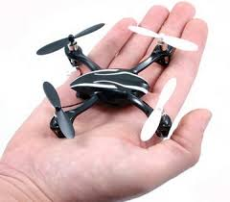
Applying Safety Continuum to UAS
Increasing Operator Certification
Zero Risk
No Operations
No Innovation
>12,500 lbs. (Global Hawk)
Society’s Demand for Safe Outcomes
>2,000 lbs. (Predator)
>1,000 lbs. (Hunter)
<55 lbs. (Scan Eagle)
<4.4 lbs. (3DR Solo)
<2.5 lbs. (DJI Phantom)
Societally Accepted Risk
& Desire for Low Cost
<1 lbs. (Parrot Bebop)
<0.5 lbs. (Hubsan X4)
Less Demand
Public Demand for Safety Assurance
More Demand
Absolute Safety
Notes:
In the same way, we are addressing Unmanned system in a scalable, risk based manner.
We know we cannot completely eliminate risk, so we must identify what level of risk society finds acceptable. What risks are we willing to live with, and what poses an unacceptable level of risk?
We are looking for that sweet spot to balance the safety of people on the ground and in the skies, but also allow for this innovative technology to meet its full potential
The chart shows risk by weight, but we are really using energy as our primary means to measure risk.

Slide 11
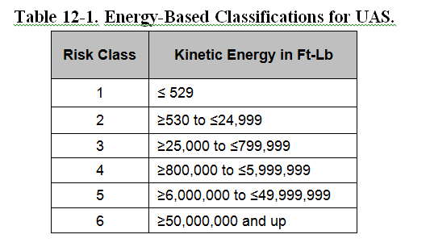
Risk Classes Based on Kinetic Energy
Falling Energy for Rotorcraft
Cruise Speed and Mass used for fixed wing calculation
Risk Classes 1-2 are primarily used under part 107.
Risk Classes 1-3 should not require TC in the future, once Permit to Fly is in place.
Risk Classes 4-6 are “typical” certification processes.
Notes:
The tale shows the actual thresholds in kinetic energy that were proposed for Airworthiness and Design Certification and classification of risk for UAS

Slide 12
Different Levels of Risk and Certification
Small UAS:
Low risk
Low involvement from Aviation Authority
Limitations: <55 lb.
Visual line of sight, <400 ft. altitude, distance from airports and no ops over people
Specific Use Cases:
Increased risk
Operation by Waiver, Certificate of Authorization, Airworthiness
Specific requirements on drone, personnel, equipment based on safety assessment and using industry standards
Fully Certified
High Risk
Fully Integrated Operations
Risk-based Regulatory Structure similar to manned aviation
FAA Design and Production Certificates
CFR Part 107
Waivers/Exemptions/Future Part 21 Changes
Typical Level of Certification
Notes:
So even though we have six different risk classes that are related to kinetic energy for the determination of certification requirements, we only have three main categories of Unmanned systems and the applicable regulations.
First, the small, low risk UAS that are below 55 lb.
At the opposite end are the fully type certified aircraft that have full integration into the airspace with other manned aircraft.
In the middle are the medium risk and special use case aircraft. These are evaluated on a case-by-case basis, and specific requirements are applied to allow safe operations.

Slide 13
Emerging UAS Regulatory Structure
Risk Based Approach
Increasing risk to public / mitigations / requirements
14 CFR 21.17(b) Special
Class Type Certification
“Rule by Rule” Use of Part 23/27
Airworthiness Certification
Production Approval/PC
Design Approval/TC
Customized Standards
Operating Limitations
Size/Energy
Part 21 “Permit to Fly”
“Specific Risk” Approach
Airworthiness Certification
Operating Limitations Size/Energy
Based on Industry Standards
Pending Rule
Part 107, Small UAS
Operating Limitations
Size / Energy
Notes:
This chart shows how our current regulatory structure reflects the three major categories of UAS
We are making a change to our part 21 rules for the “middle” class of UAS, where we will rely heavily on industry standards for certification. They are medium risk and may not rise to a risk level that requires a full TC/PC type cert and production cert.
PTF intended for certain, medium risk UAS:
Beyond the scope of part 107 but risks below the need for TC/PC
Meet FAA accepted industry standards
As applicable for design, construction, quality, production acceptance, maintenance, AFM, OOP, BVLOS
Simple operator inputs based on “automation”
FAA will continue working with industry to encourage the development of standards.

Slide 14
Resulting Risk-Classes Overlaid with Rules
Top Down
Risk Analysis
§23.1309
Std. Certification*
§21.17(b)
Risk Class 6
(P25)
Cert Basis Requirements Based on Risk*
Cert
Level
Risk Class 5
(P23 Twin)
Risk Class 4
(P23 Single)
Part 21 Permit
To Fly *
Risk Class 3
(LSA)
Bottom Up Risk Analysis
No Airworthiness*
Part 107
Risk Class 2
(SUAS)
Risk Class 1
(Micro)
Part 107 Expansions
Hobby
“SORA”
Increasing Risk to Public
* Dependent Upon Operational Integration
Notes:
This shows the regulatory structure in slide 13 overlaid with the six energy based risk classes from slide 11. There is a natural progression of risk to the public and to our airspace as we go from the left to the right.

Slide 15
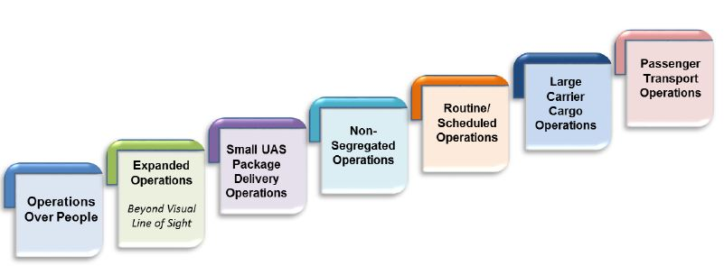
Risk-Based Operational Classification Strategy
For Applicability of Operational Requirements - Address Operational Risk Exposure While Avoiding a “Zero-Risk” Mentality
Increasing
Level of
FAA Rigor
Increasing Level of Operational Integration
Notes:
Those different operational uses have led to the 7 operational risk classes that are being considered for the UAS integration plan. They represent an increasing level of rigor moving left to right, just as the kinetic energy based risk classes do. It is also likely the left side use-cases will start with small UAS at low altitude, while the ones on the upper right will likely be larger UAS at altitudes above 500 feet.

Slide 16
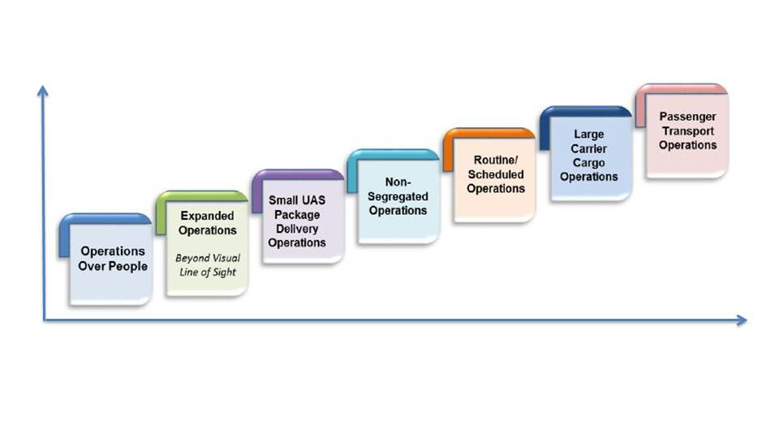
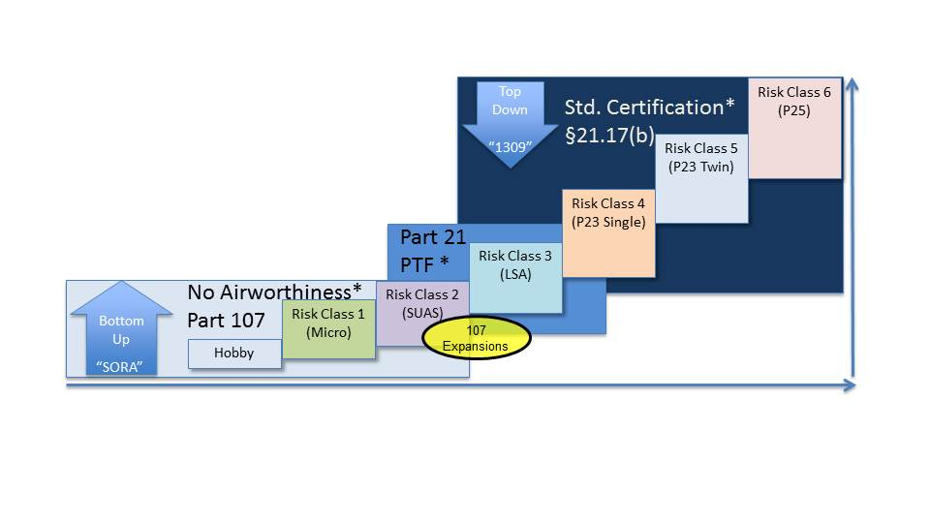
Two Classifications Are Notionally Related
“Typical Use-Case” Related to Size, Capability, & Performance
Level of Integration sets Requirements, Level of FAA Oversight, and Involvement in Operation
Operation
Related to
Capability
Aircraft Capability Drives Possible Operations
Notes:
The operational risk classes have a notional relation to the energy based risk classes, and therefore the regulatory structure, since the capabilities of the aircraft drive what operational use cases are realistic. In the same manner, the operational use cases require certain performance capabilities, so only certain classes of aircraft can perform the proposed operation.
You will see that it may be possible notionally to enable small package delivery on an aircraft that has a low level of FAA airworthiness and design certification. This is true for remote areas, but as the operation is done in populated areas, the level of certification will need to increase to offset the potential risk to the public.

Slide 17
Status Update - Summary of UAS Activities

Slide 18
Status, As of October 2017
Thousands of UAS Registrations, Remote Pilots, & Operations Enabled Under Part 107
  UAS Registrations Surpassed Manned Aircraft Totals in First Year – Now Over 900K vs. 320K manned
Working Towards Expanded Operations
Roughly Twelve Type Design Certification Programs Underway
  Ranging From 5 to 15,000 lb.
  Prefer to Work Lower Risk First – Learn by Doing

Slide 19
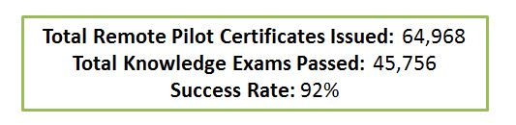
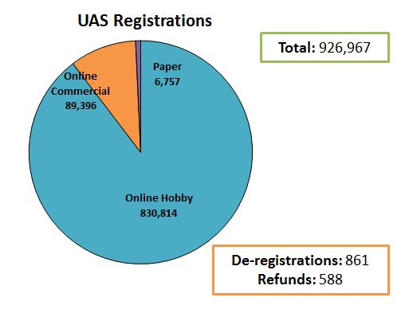
Part 107 Progress
Registration Issued in December 2015, and by June 2016, 500,000 sUAS vehicles were registered, considerably higher than the 320,000 registered piloted aircraft.
August ‘16, regulations for civil operation of non-hobbyist drones weighing less than 55 lbs. Visual Line of Sight. Not Over People
  Vehicles under 0.55 lbs. did not need to register.
  Over 55 lbs. registered via the paper-application used for on-board piloted aircraft.
Latest Totals for 10/17

Slide 20
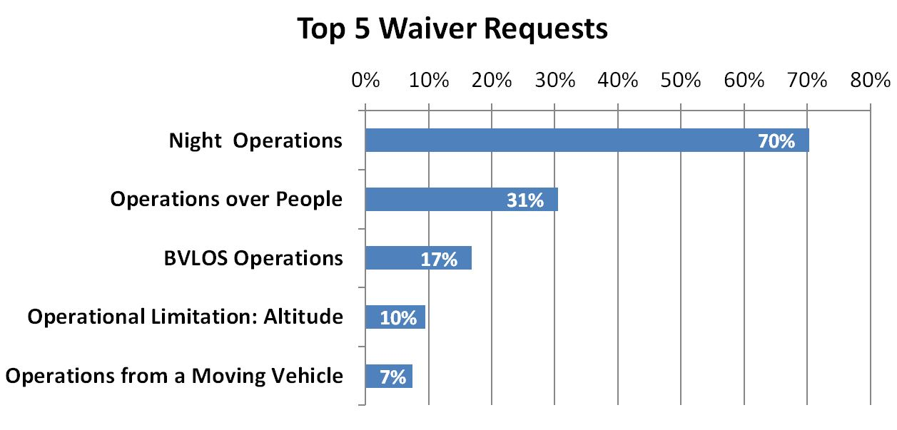
Waivers to Part 107
Certain Parts of 107 Can Be Waived, based on Safety Case
Each is Evaluated Based on Specific Operational Risk

Slide 21

Certification Lessons Learned
Certification Requirements Driven by Aircraft, Intended Concept of Operation, and Airspace/Area it Will Operate in
Applicant Must Perform an Operational Risk Assessment Showing They Understand Their Impact on the Pubic/Existing Airspace
Many Technology/Policy Decisions Still Made on a Case-by-Case Basis – No Single Answer or Silver Bullet
Operational Integration is Largest Challenge – §91.113
  No Single Manufacturer Has Come With Data or Even a Demonstrated Concept to Show They Can Integrate in the NAS

Slide 22
Key Items To Enable UAS Certification
Regulatory improvements – Part 107, Part 21, and Part 23
  Performance-based regulations - top-level safety goals
  Customizable design/certification requirements through collaborative Means of Compliance
Standards for Electric Propulsion/lift systems
  Developing Requirements & Experience in UAS
  Recognize potential safety/efficiency benefits
Augmented flight path control & automation (“Autonomy”)
  Collaboration for best practices, design requirements, architecture with industry, NASA, academia
  Gradual transfer of pilot responsibility/workload to Automation

Slide 23
Safety From Experience
We have a history of finding ways to bring new technology into the National Airspace System safely
We are already using a well-proven risk-based approach to safety
Society Recognizes a need for balance regarding FAA Rigor vs. Safety Improvement – Drives cost, time for project
UAS Certification will lead to future technology benefits for manned aviation

Slide 24
UAS Operations
Increasing Risk | Aircraft Requirements | UAS Registration | Pilot Requirements | Types of Operation | Airspace Requirements
Part 101 Model Aircraft | UAS < 55 pounds *unless otherwise certified through a CBO | Registration not required* *Voluntary registration encouraged | Community-Based Organization (CBO) standards | Hobby or recreational, VLOS, Part 101 operating rules, CBO standards | Notification requirement within 5 miles of an airport
Part 107 | UAS < 55 pounds | Register through Small UAS Registration Service | Part 107 remote pilot certificate with small UAS rating | VLOS, daytime, Class G, 400 ft, not over people OR waiver provisions | Airspace waiver or authorization for Class B, C, D, E airspace
Section 333 | As specified in exemption | For UAS > 55 pounds, N-number registration required | Part 61 airman certificate | UAS > 55 pounds | Blanket COA or standard COA for specific airspace
Public Aircraft | Self-certification by public agency | For UAS > 55 pounds, N-number registration required | Self-certification by public agency | Public Aircraft Operations (AC 00-1.1A); UAS Test Site Operations | Blanket COA or Standard COA for specific airspace
Experimental Aircraft | Experimental Special Airworthiness Certificate | For UAS > 55 pounds, N-number registration required | Part 61 airman certificate | Research and Development, crew training, and market survey | Standard COA for specific airspace
Type Certificated Aircraft | Restricted type or special class certificate | For UAS > 55 pounds, N-number registration required | Part 61 airman certificate | Specified in operating authorization | Part 91 airspace requirements

Slide 25
Importance of Registration
Support FAA safety programs and agency management
  Provide aircraft owners and operators information about potential mechanical defects or unsafe conditions of their aircraft
  Educate owners regarding safety requirements for operation
Aid law enforcement and aircraft accident investigations
Repository of legal documents to determine legal ownership of aircraft
Aid in national defense and support safe and economically strong civil aviation system

Slide 26
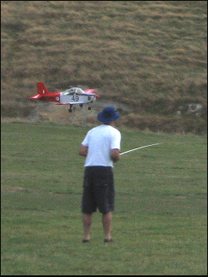

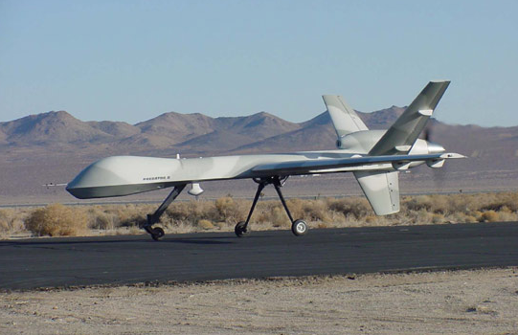
UAS Registration
Unless operating under Special Rule for Model Aircraft, UAS must be registered with FAA:
Registration not required*
Registration required
Flying under the Special Rule for Model Aircraft
UAS weighing between 0.25 Kg and 25 Kg may use online sUAS Registration Service
UAS weighing more than 25 Kg must register using traditional aircraft registration under 14 CFR Part 47
* Registration still encouraged

Slide 27
Flying under Special Rule for Model Aircraft
Model aircraft operators that comply with all of these operational requirements during flight do not have to register their UAS with the FAA:
  Aircraft is flown strictly for hobby/recreational use
  Aircraft is operated in accordance with community-based set of safety guidelines and within the programming of a nationwide community-based organization
  Aircraft is limited to not more than 55 lbs (25 Kg) unless otherwise certified through a design, construction, inspection, flight test, and operational safety program administered by a community-based organization
  Aircraft is operated in a manner that does not interfere with and gives way to any manned aircraft
  when flown within 5 miles of an airport, the operator of the aircraft provides the airport operator and the airport air traffic control tower (when an air traffic facility is located at the airport) with prior notice of the operation (model aircraft operators flying from a permanent location within 5 miles of an airport should establish a mutually-agreed upon operating procedure with the airport operator and the airport air traffic control tower [when an air traffic facility is located at the airport])

Slide 28

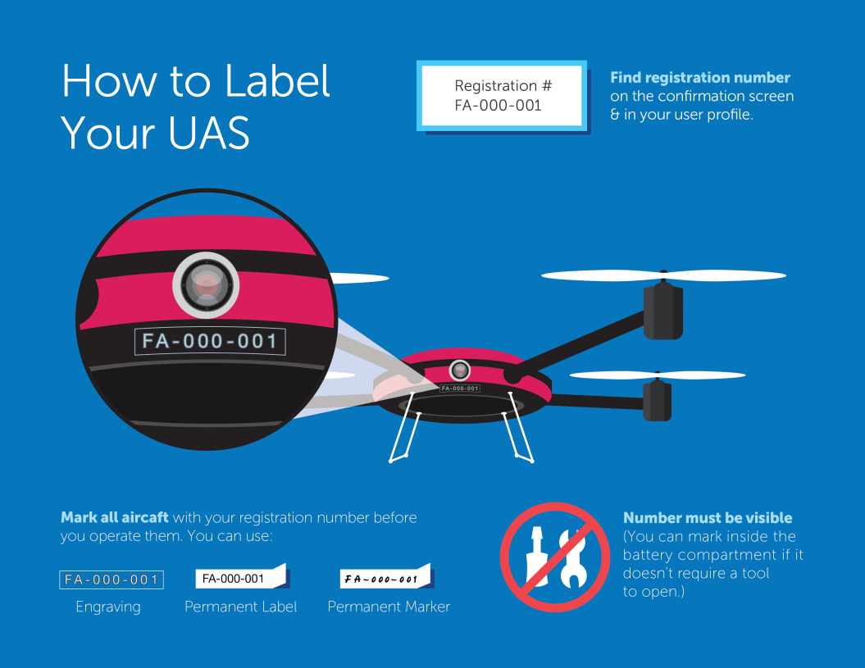
sUAS Registration
For UAS between .25 KG and 25 KG, register through sUAS Registration Service
and
label the sUAS

Slide 29
sUAS Registration Facts and Requirements
Person must be 13 years of age or older
Person must be a U.S. citizen or legal permanent resident*
In order to register, applicant needs:
  Email address
  Credit/debit card
  Physical address and mailing address
  Make and model of UAS
Registration costs $5 and is valid for 3 years
*visiting foreign nationals must register their UAS upon arrival in the U.S.

Slide 30
Traditional Aircraft Registration
Registration under 14 CFR Part 47 is required:
  For Unmanned aircraft that weigh 55 lbs (25 Kg) or more,
  For sUA owned by a trustee under a trust agreement,
  When the sUA owner uses a voting trust to meet U.S. Citizen requirements
Registration under 14 CFR Part 47 is available:
  For sUA that need N-number registration to operate outside the U.S.
  When public recording is desired for a sUA’s loan, lease, or ownership documents

Slide 31
Registration under Part 47
Owner must provide:
  Aircraft Registration Application, AC Form 8050-1
  Notarized affidavit establishing the required description of the UA, the ownership of the UA, that the UA is not registered in another country
  An N-number to be assigned to the registered aircraft
  A $5.00 registration fee

Slide 32
UAS Operations
Increasing Risk | Aircraft Requirements | UAS Registration | Pilot Requirements | Types of Operation | Airspace Requirements
Part 101 Model Aircraft | UAS < 55 pounds *unless otherwise certified through a CBO | Registration not required* *Voluntary registration encouraged | Community-Based Organization (CBO) standards | Hobby or recreational, VLOS, Part 101 operating rules, CBO standards | Notification requirement within 5 miles of an airport
Part 107 | UAS < 55 pounds | Register through Small UAS Registration Service | Part 107 remote pilot certificate with small UAS rating | VLOS, daytime, Class G, 400 ft, not over people OR waiver provisions | Airspace waiver or authorization for Class B, C, D, E airspace
Section 333 | As specified in exemption | For UAS > 55 pounds, N-number registration required | Part 61 airman certificate | UAS > 55 pounds | Blanket COA or standard COA for specific airspace
Public Aircraft | Self-certification by public agency | For UAS > 55 pounds, N-number registration required | Self-certification by public agency | Public Aircraft Operations (AC 00-1.1A); UAS Test Site Operations | Blanket COA or Standard COA for specific airspace
Experimental Aircraft | Experimental Special Airworthiness Certificate | For UAS > 55 pounds, N-number registration required | Part 61 airman certificate | Research and Development, crew training, and market survey | Standard COA for specific airspace
Type Certificated Aircraft | Restricted type or special class certificate | For UAS > 55 pounds, N-number registration required | Part 61 airman certificate | Specified in operating authorization | Part 91 airspace requirements

Slide 33
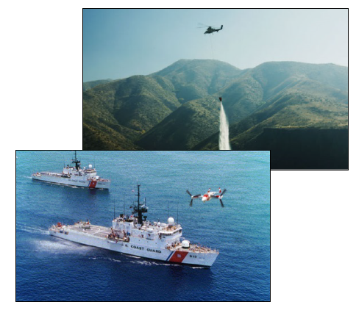
RPIC Certification and Responsibilities
Getting your Certificate
  Starting from Scratch
  Already a certified Pilot?
Remote Pilot In Command (RPIC) Responsibilities
  Register your Aircraft
  Preflight Aircraft and Crew
  Assess the Operating Environment
  Designated RPIC, be RPIC
  Adhere to Operating Rules
  Fly Safe

Slide 34
Becoming a Remote Pilot under Part 107
Eligibility
Must be 16 years old or older
Must read, speak, write, and understand English
No physical or mental condition that would interfere with the safe small UAS operations
Must pass an aeronautical knowledge exam at an FAA-approved Knowledge Testing Center
  Current Part 61 certificate holders can take training at faasafety.gov instead of the knowledge test
Must undergo TSA Background security screening
Total Remote Pilot Certificates Issued: 66,245
Total Knowledge Exams Passed: 46,733
Success Rate: 92%

Slide 35
Becoming a Remote Pilot under Part 107
Starting from Scratch
Go to http://www.faa.gov/uas
Prepare for knowledge test
  60 questions, 70% required to pass
  Covers broad range of topics
  FAA test prep available online
Pass the knowledge test
Apply for the certificate (http://iacra.faa.gov)
Download temporary certificate
Fly! Your permanent certificate will be mailed to you in a few weeks

Slide 36
Becoming a Pilot under Part 107
Already Certificated Pilots
Go to http://www.faa.gov/uas
Are you flight review current (§61.56)?
Take the online training course
Apply for the certificate (http://iacra.faa.gov)
Upload training course completion certificate in IACRA
Submit required documents to approving official (FSDO, DPE, ACR, or CFI)
Receive temporary certificate

Slide 37
Knowledge Area Topics
Knowledge Area Topics | New Remote Pilots |  | Current Part 61 Pilots
(from §107.73 and 107.74) | Initial | Recurrent | Initial | Recurrent
Applicable regulations relating to small UAS | X | X | X | X
Airspace classification, operating requirements, and flight restrictions | X | X
Aviation weather sources / effects of weather on small unmanned aircraft performance | X/X |  | -/X
Small unmanned aircraft loading | X |  | X
Emergency procedures | X | X | X | X
Crew resource management | X | X | X | X
Radio communication procedures | X
Determining the performance of small unmanned aircraft | X |  | X
Physiological effects of drugs and alcohol | X
Aeronautical decision-making and judgment | X | X
Airport operations | X | X
Maintenance and preflight inspection procedures | X | X | X | X

Slide 38
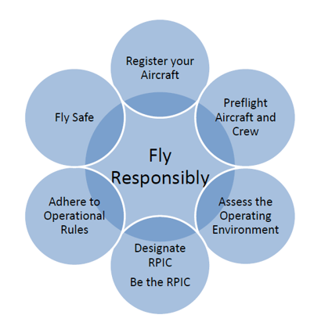
Your Responsibility as RPIC

Slide 39
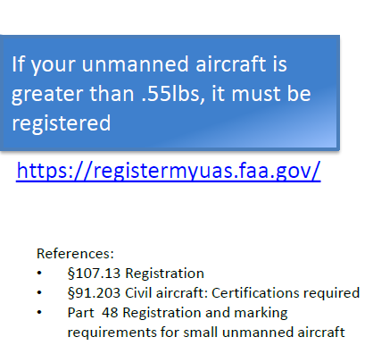
Your Responsibility as RPIC

Slide 40
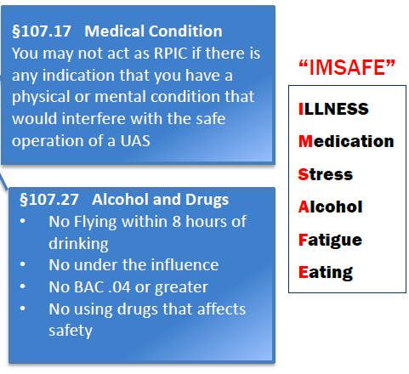
Your Responsibility as RPIC

Slide 41
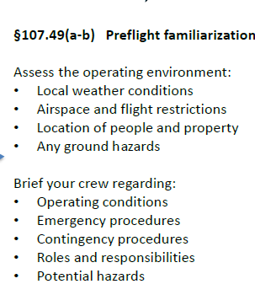
Your Responsibility as RPIC

Slide 42
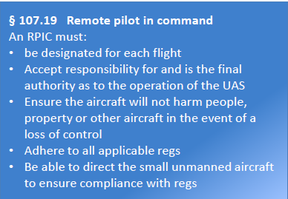
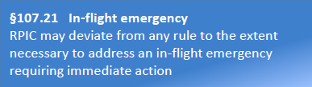
Your Responsibility as RPIC

Slide 43
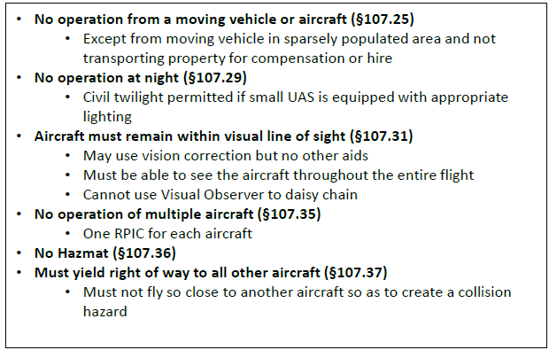
Your Responsibility as RPIC

Slide 44
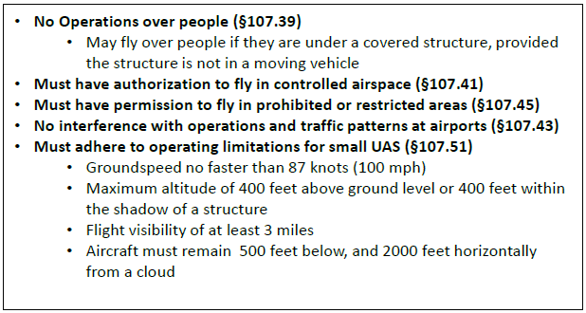
Your Responsibility as RPIC

Slide 45
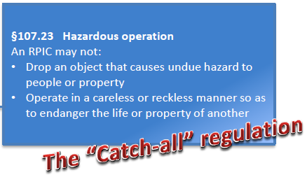
Your Responsibility as RPIC

Slide 46
UAS Operations
Increasing Risk | Aircraft Requirements | UAS Registration | Pilot Requirements | Types of Operation | Airspace Requirements
Part 101 Model Aircraft | UAS < 55 pounds *unless otherwise certified through a CBO | Registration not required* *Voluntary registration encouraged | Community-Based Organization (CBO) standards | Hobby or recreational, VLOS, Part 101 operating rules, CBO standards | Notification requirement within 5 miles of an airport
Part 107 | UAS < 55 pounds | Register through Small UAS Registration Service | Part 107 remote pilot certificate with small UAS rating | VLOS, daytime, Class G, 400 ft, not over people OR waiver provisions | Airspace waiver or authorization for Class B, C, D, E airspace
Section 333 | As specified in exemption | For UAS > 55 pounds, N-number registration required | Part 61 airman certificate | UAS > 55 pounds | Blanket COA or standard COA for specific airspace
Public Aircraft | Self-certification by public agency | For UAS > 55 pounds, N-number registration required | Self-certification by public agency | Public Aircraft Operations (AC 00-1.1A); UAS Test Site Operations | Blanket COA or Standard COA for specific airspace
Experimental Aircraft | Experimental Special Airworthiness Certificate | For UAS > 55 pounds, N-number registration required | Part 61 airman certificate | Research and Development, crew training, and market survey | Standard COA for specific airspace
Type Certificated Aircraft | Restricted type or special class certificate | For UAS > 55 pounds, N-number registration required | Part 61 airman certificate | Specified in operating authorization | Part 91 airspace requirements

Slide 47
Small UAS Operations
 | Recreational Only Operations | Commercial and Other Operations
Pilot Requirements | No FAA pilot requirements | Must have Remote Pilot Airman Certification Must be 16 years or older Must pass TSA vetting
Aircraft Requirements | UAS over 55 pounds must be certified through a design, construction, inspection, flight test, and operational safety program administered by a community-based organization | Must be less than 55 pounds Must be registered if over 0.55 pounds Must undergo pre-flight checklist
Location Requirements | Must notify all airports and air traffic control (if applicable) within five miles of proposed area of operations | Class G airspace without ATC permission Class B, C, D, and E require ATC permission
Operating Rules | Must ALWAYS yield right of way to manned aircraft Must keep aircraft in visual line-of-sight Must follow community-based safety guidelines | Must keep aircraft in visual line-of-sight* Must fly under 400 feet* Must fly only during daylight hours* Must fly at or below 100 mph* Must yield right of way to manned aircraft* Must NOT fly over people* Must NOT fly from a moving vehicle*
Definitions | Education or recreational flying only | Flying for commercial use Flying incidental to a business Flying public aircraft operations
*These requirements are subject to waiver.

Slide 48
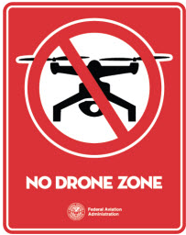

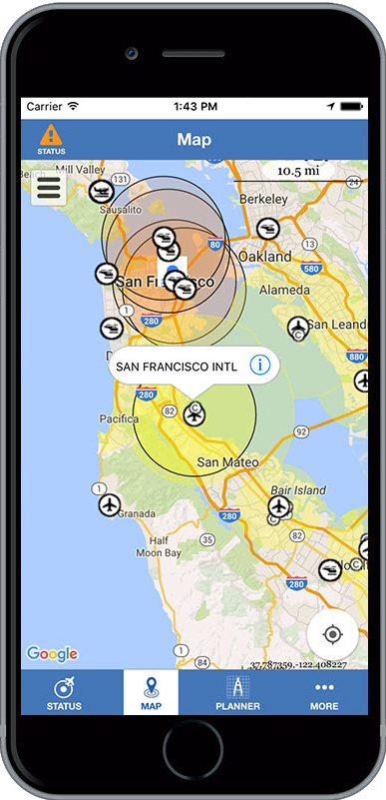
Airspace Restrictions
Airspace restrictions commonly affecting UAS flights:
Security Sensitive Airspace Restrictions
Temporary Flight Restrictions
Restricted or Special Use Airspace
Stadium and Sporting Events
Wildfires
Airports
B4UFLY Mobile Application
Available for most mobile smart phones
Helps UAS operators determine whether there are any restrictions or requirements at the location they want to fly
Notes:
The FAA, under 14 CFR § 99.7 — Special Security Instructions (SSI), has prohibited all UAS flights within the airspace defined under UAS NOTAM FDC7/7282. The restrictions extend from the ground up to 400 feet AGL, apply to all types and purposes of UAS flight operations, and remain in effect 24 hours a day, 7 days a week.
Temporary Flight Restrictions (TFRs) define a certain area of airspace where air travel is limited because of a temporary hazardous condition, such as a wildfire or chemical spill; a security-related event, such as the United Nations General Assembly; or other special situations. The text of the actual TFR contains the details about the restriction, including the size, altitude, time period that it is in effect, and what types of operations are restricted and permitted.
The "Map Airports" tab on the TFR website can help narrow down the relevant active TFRs in a specific area
The airspace surrounding Washington DC is the most restricted in the country. Flying your drone is illegal in any of the restricted airspace above the Nation's capital. For more information, read about No Drone Zone.
Special use airspace is used to designate airspace in which certain activities must be confined, or where limitations may be imposed on aircraft operations that are not part of those activities. Types of Special Use Airspace include:
Prohibited areas
Restricted areas
Warning areas
Military operation areas (MOAs)
Alert areas
Controlled firing areas (CFAs)
For more detailed information about airspace classifications and categories, review the Pilot's Handbook of Aeronautical Knowledge.
Flying UAS in and around stadiums is prohibited starting one hour before and ending one hour after the scheduled time of any of the following events:
Major League Baseball
National Football League
NCAA Division One Football
NASCAR Sprint Cup, Indy Car, and Champ Series races
Specifically, UAS operations are prohibited within a radius of three nautical miles of the stadium or venue.
Further information is available in this handout on sports TFRs (PDF)
It is illegal to fly your UAS in or around a wildfire firefighting operation.
Recreational operators are required to give notice for flights within five miles of an airport to both the airport operator and air traffic control tower, if the airport has a tower. However, recreational operations are not permitted in Class B airspace around most major airports without specific air traffic permission and coordination

Slide 49
Operating Beyond Part 107
Operational boundaries of Part 107 are being challenged by commercial needs
FAA planning and evaluating regulatory evolution to support new operations: e.g. package delivery, cargo, passenger transport

Slide 50
Standards Developing Organizations

Slide 51
Advantages of Industry Standards
Helps us keep pace with technology
Provides Industry-based definition of acceptable safety standards
Globally acceptable
  Single standard accepted by multiple authorities
Legally defensible foundation
  Keeps any single authority from driving to conservative level of safety
  Reduces liability of company if they meet accepted standard

Slide 52
Advantages, Cont’d
OMB Circular 119 encourages the use of consensus standards as much as practicable in our future rulemaking
That is one of the motivations behind their use in our part 23 rewrite

Slide 53
Many Global Players
ISO, ANSI, NIST, RTCA, JARUS, ICAO, ASTM, SAE, all working/coordinating standards
  Each standards body has inherent expectations for timelines, process, and product delivery
  These may dictate who is best for a particular standard – ie. international vs. domestic, etc.
ANSI is tracking matrix of standards
  Need to Leverage Strengths vs. Industry Needs
  Standards for Avionics/Equipment vs. Ops Integration
  Avoid Duplication of Efforts, or assignment to “wrong” group
  Coordinate with EUSTG (European UAS Standards Coordination Group)

Slide 54
Supporting Slides

Slide 55
Key Concept– Risk Analysis
A “Zero Risk” Mentality Will Not Work
  Initial Automation Implementation Will Need “Fail Safe” Mentality, May Need Human Intervention
Traditional Certification, Risk Assessment, and Mitigations May Or May Not Be Appropriate For UAS – Unique Design and Operational Risks
Scalable, risk-based requirements leads to increase in safety – Spawn new innovation

Slide 56

Defining Risk For UAS
Contributing Factors
  Vehicle Design/Systems – What is it?
  Operational Risk – How will it be used?
  Area of Operation/Airspace – Where will it be flown?
  Airspace – What’s its Separation Strategy?
  Human vs. Automation – Have you Planned for Errors?
We need a clear, documented Concept of Operation, and Operational Risk Assessment
  Proposed Mission Drives Requirements and FAA Involvement
  Main Issue is Safe Operational Integration
  Level of Airworthiness Appropriate

Slide 57
Combined UAS Risk Controls
Operational Safety
Target
Systems, airspace, ops, maintenance, & pilot error all feed into operational safety
Typically Apply System Safety Techniques “XX.1309” for aircraft systems
Some try to fix top level targets with increasing 10E^{-X} for system failures
Not the right solution, we don’t have data to model pilots, weather, etc.
Combined Safety Mitigations
System
Failure
Ops/Pilot
Error
Airspace/
Population
Weather
Maint

Slide 58
Risk Analysis – Public Expectation
The FAA is legally responsible for aviation safety – we have the safest system in the world
  FAA must safely manage the airspace civil operations, per Title 49 U.S. Code § 40103(a)(1)
The public depends on competent risk assessment and risk mitigation
  When risks are overlooked--public skepticism abounds.
Balance is important – overestimating risk can lead to high cost, complexity, and stagnation in innovation
  New Transportation Concepts will challenge us all

Slide 59
What’s Our Safety Target for UAS ?
Depends, but FAA Expectation Not the Same For All UAS, and 10e⁻⁹ May Not Be the Default
We don’t have one target for manned Aircraft
  We have Scalable, Multi-Tiered Safety Targets
    Experimental, Amateur Built, Part 23 fixed wing, and part 27 rotorcraft, Part 25 transports and part 29 rotorcraft
  Also have Multiple levels of Operational Oversight
    Part 91, 121, etc.

